Slide 1



Customer Churn Analysis
View in Power BI
Last data refresh:
24/04/2025 15:22:56 UTC
Downloaded at:
24/04/2025 15:24:39 UTC

Slide 2
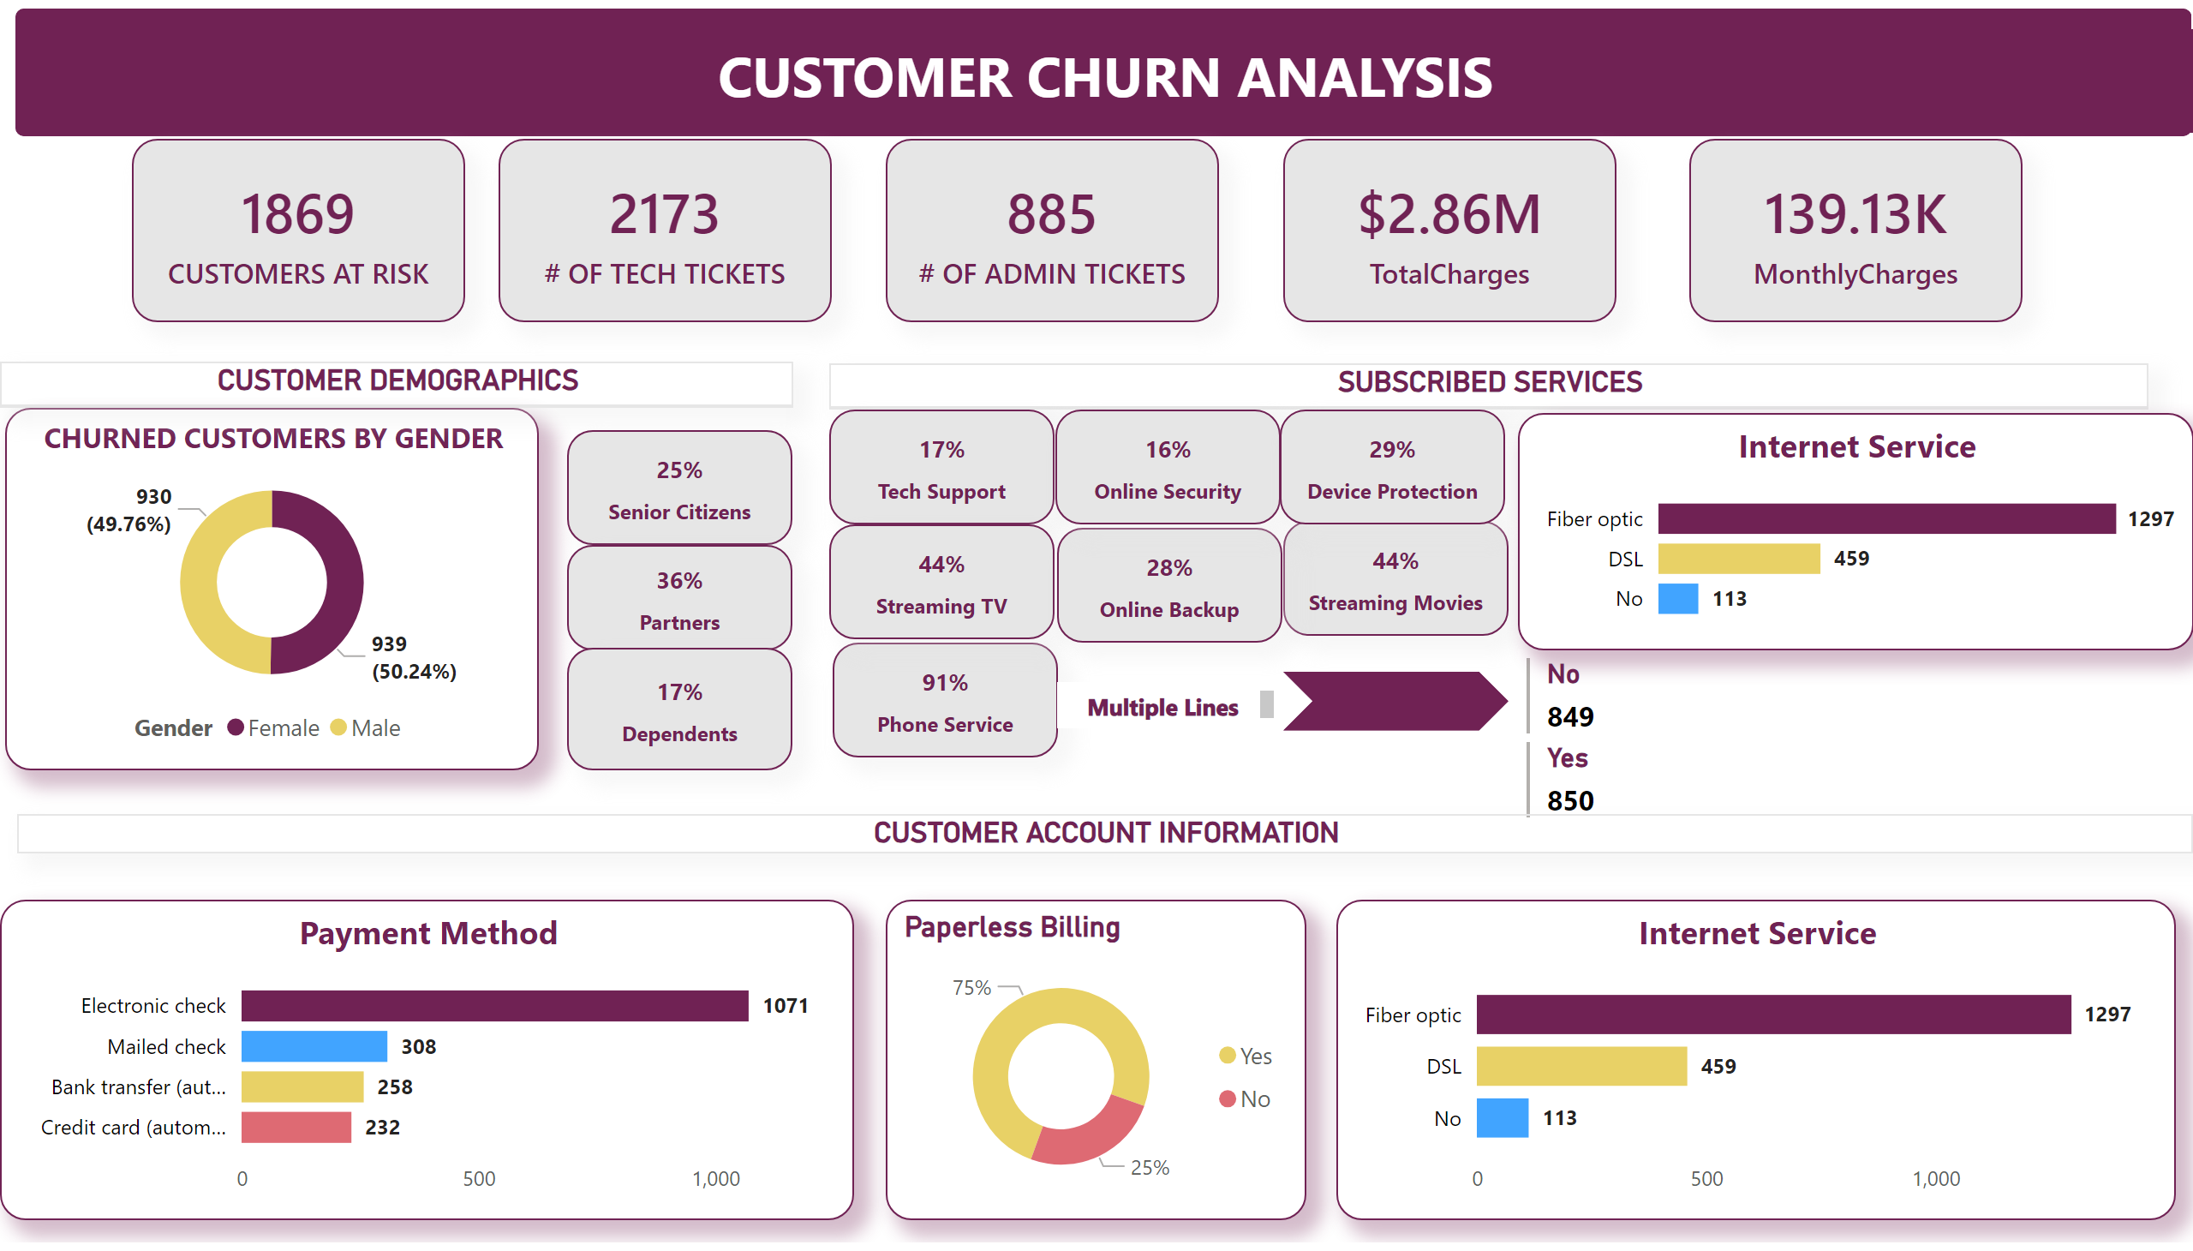
Page 1
Notes:
shape
No alt text provided
textbox
No alt text provided
card
No alt text provided
card
No alt text provided
card
No alt text provided
card
No alt text provided
card
No alt text provided
CHURNED CUSTOMERS BY GENDER
No alt text provided
CUSTOMER DEMOGRAPHICS
No alt text provided
card
No alt text provided
card
No alt text provided
card
No alt text provided
SUBSCRIBED SERVICES
No alt text provided
card
No alt text provided
card
No alt text provided
card
No alt text provided
card
No alt text provided
card
No alt text provided
card
No alt text provided
card
No alt text provided
multiRowCard
No alt text provided
Multiple Lines
No alt text provided
textbox
No alt text provided
Internet Service
No alt text provided
CUSTOMER ACCOUNT INFORMATION
No alt text provided
Payment Method
No alt text provided
Paperless Billing
No alt text provided
Internet Service
No alt text provided

